Slide 1
OpenChain Korea Work Group
2024-03-26

Slide 2
Anti-Trust Policy Notice
Linux Foundation meetings involve participation by industry competitors, and it is the intention of the Linux Foundation to conduct all of its activities in accordance with applicable antitrust and competition laws. It is therefore extremely important that attendees adhere to meeting agendas, and be aware of, and not participate in, any activities that are prohibited under applicable US state, federal or foreign antitrust and competition laws.
Examples of types of actions that are prohibited at Linux Foundation meetings and in connection with Linux Foundation activities are described in the Linux Foundation Antitrust Policy available at http://www.linuxfoundation.org/antitrust-policy. If you have questions about these matters, please contact your company counsel, or if you are a member of the Linux Foundation, feel free to contact Andrew Updegrove of the firm of Gesmer Updegrove LLP, which provides legal counsel to the Linux Foundation.

Slide 3


Slide 4

Headline News - BlackBerrry
BlackBerry, an early adopter of ISO/IEC 5230:2020 and OpenChain Security Assurance Specification 1.1 (later ISO/IEC 18974:2023), has completed regular recertification for both standards.

Slide 5

Headline News - Circle
Circle, a leading global financial technology firm and the issuer of USDC, the world’s largest, regulated U.S. dollar-backed stablecoin, has announced an OpenChain ISO/IEC 5230 conformant program.

Slide 6
OpenChain Elections - Status
Elections Completed in January:
Specification Work Group Proposed Chair for 2024:
Chris Wood, Lockheed Martin
Education Work Group Proposed Chair for 2024 :
Andrew Katz, Orcro
Elections Completed in February / March:
Telco Work Group Proposed Chair for 2024:
Marc-Etienne Vargenau, Nokia

Slide 7
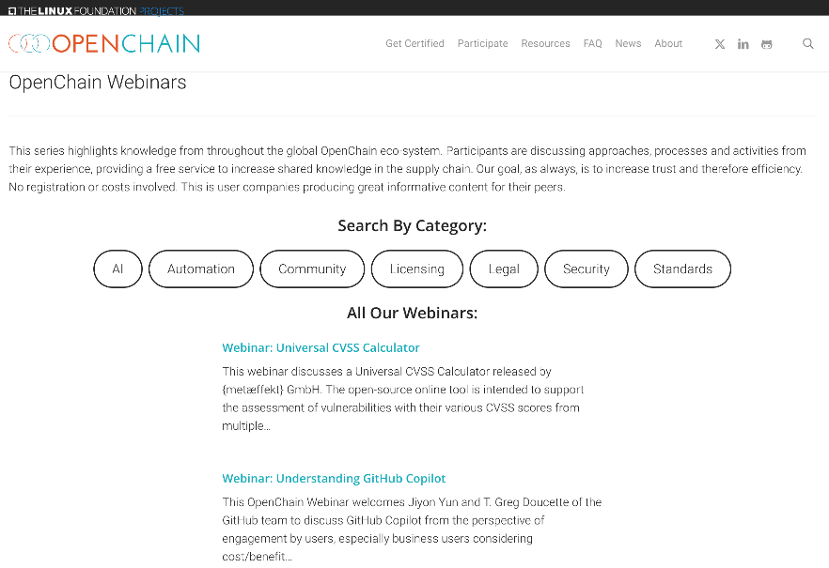
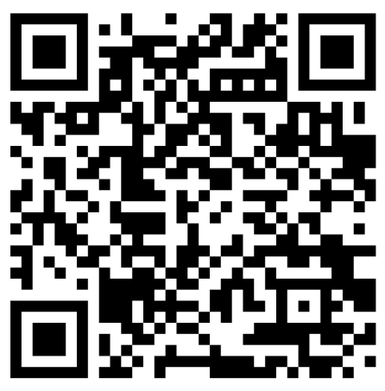
OpenChain Webinars: 72 Published Since 03/2020
https://www.openchainproject.org/webinars

Slide 8
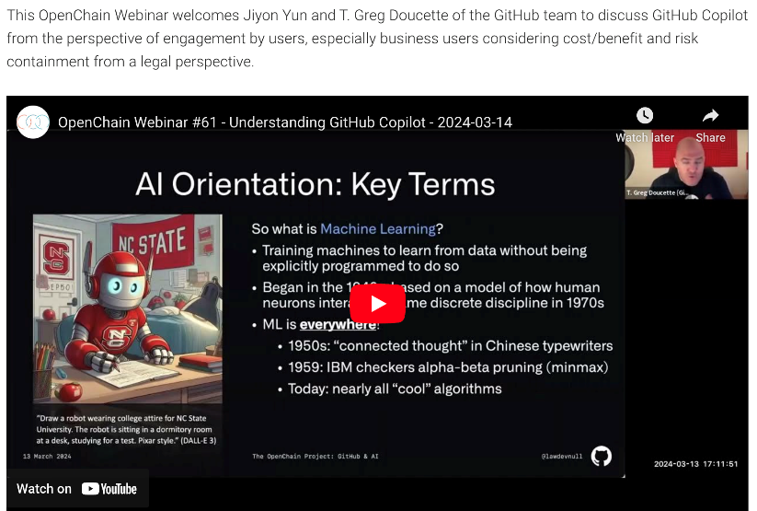
Webinar: Understanding GitHub Copilot
https://www.openchainproject.org/webinar/2024/03/14/webinar-understanding-github-copilot
Please note: webinar numbers are non-sequential due to merging categories

Slide 9
OpenChain AI Study Group
The OpenChain AI Study Group - as discussed by the board last year – has held its first meetings. The issue of AI Compliance is still being scoped, but progress is being made.
OpenChain AI Study Group Call (Europe and Asia) – 2024-03-14 – Full Recording
https://www.openchainproject.org/news/2024/03/15/openchain-ai-study-group-call-europe-and-asia-2024-03-14
Outcomes of the Special OpenChain AI Workshop – 2024-03-06
https://www.openchainproject.org/news/2024/03/13/outcomes-ai-workshop-2024-03-06

Slide 10

First South Korean Third-Party Certifier
KOSYAS is the first Official Third-Party Certifier in South Korea
https://www.openchainproject.org/news/2024/03/13/kosyas-is-the-first-official-third-party-certifier-in-south-korea

Slide 11
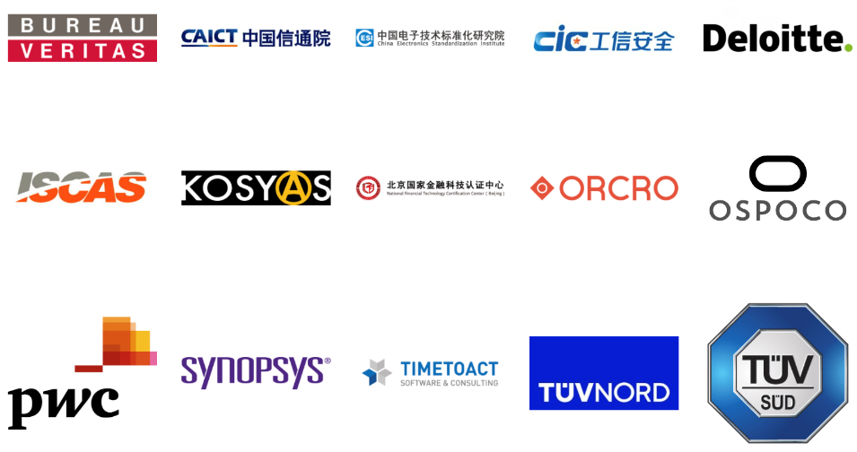
15 Official Third-Party Certifiers

Slide 12
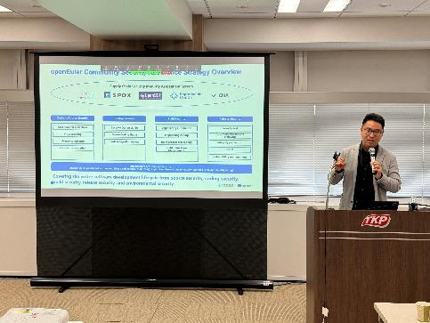

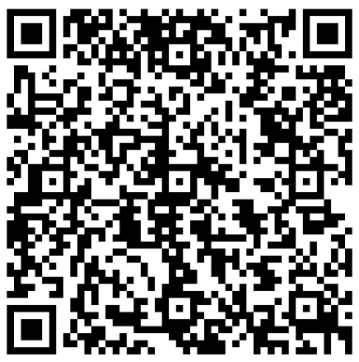
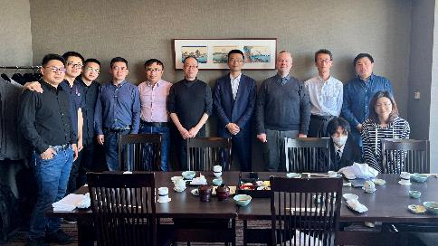


OpenChain Work Group: ISO 5230 / ISO 18974

Slide 13
Coming Soon: OpenChain Board Meeting
Today, 26th March

Slide 14
Coming Soon: New Supplier Education Leaflet
ETA April 2024

Slide 15
Coming Soon: New Training Slides
ETA April 2024

Slide 16
Let’s Do Our Best… Together!

